Slide 1

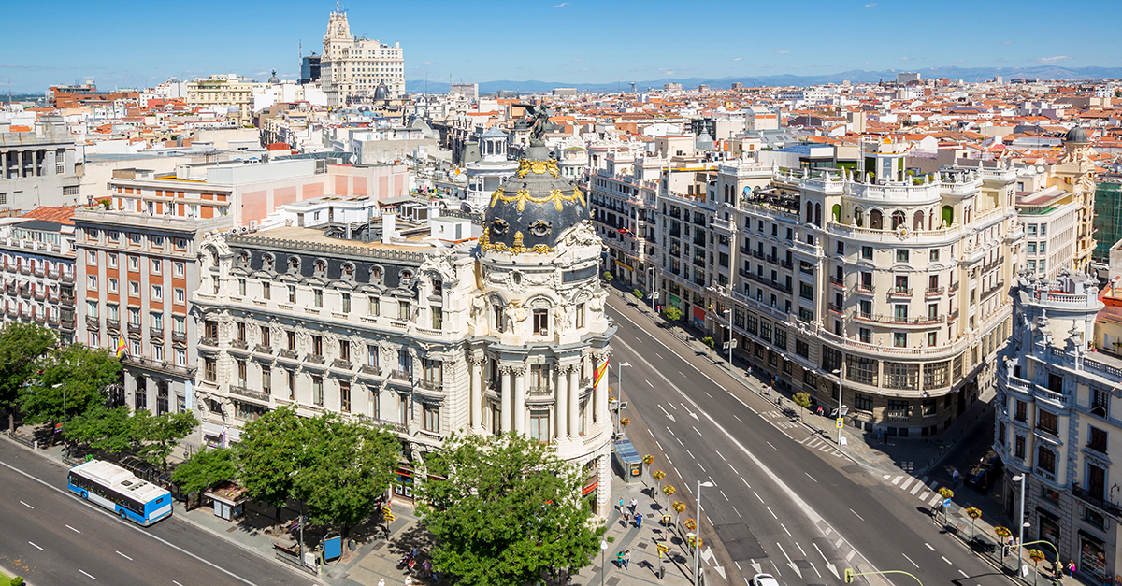
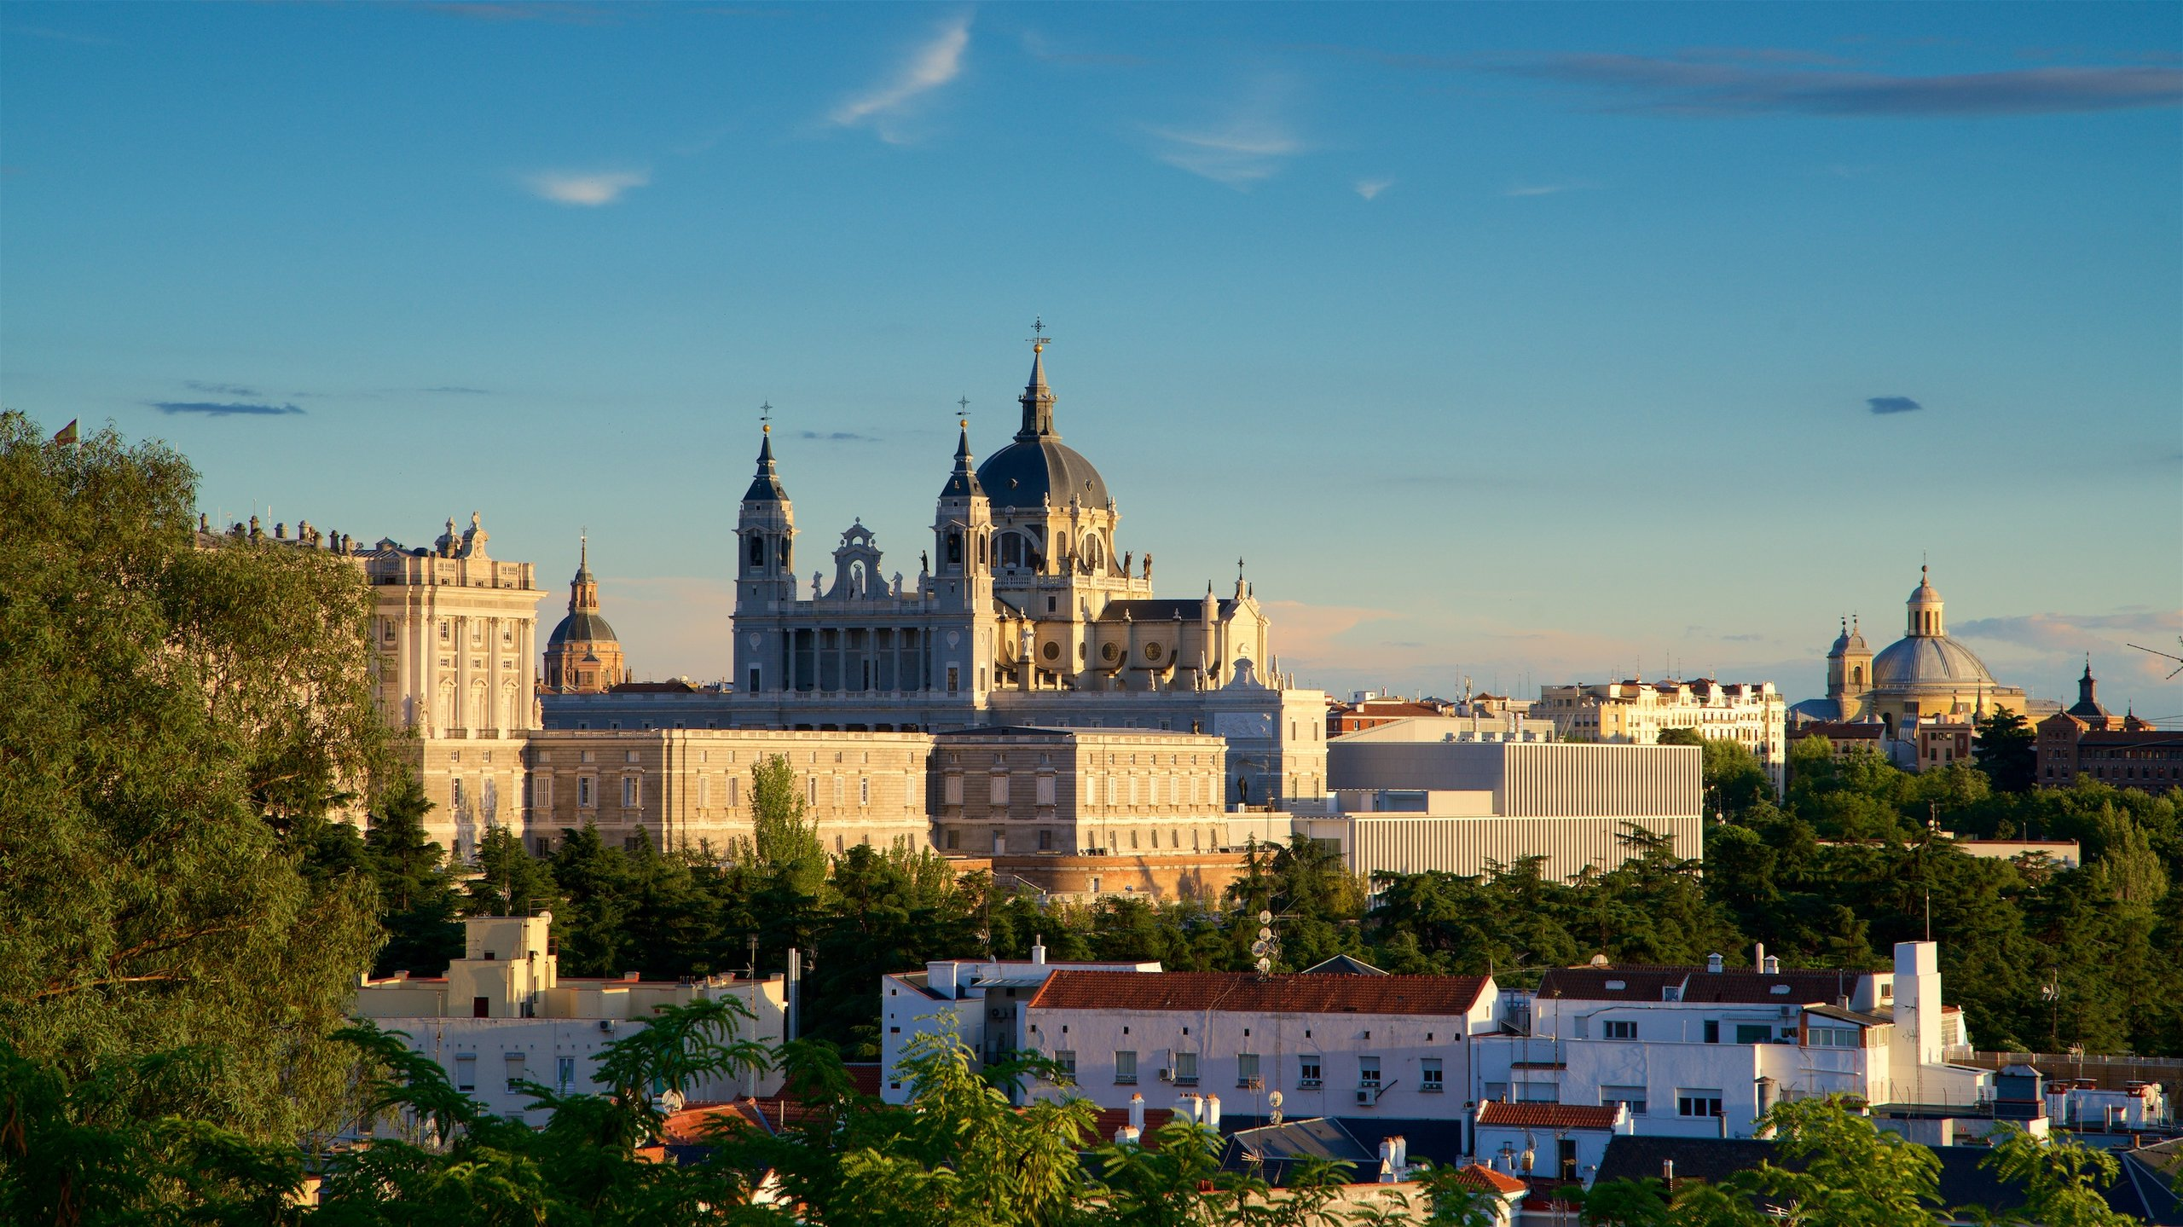

MADRID in DETAIL LA DETALYE de CIUDAD MADRID
La major ciudades capital de republica espana

Slide 2
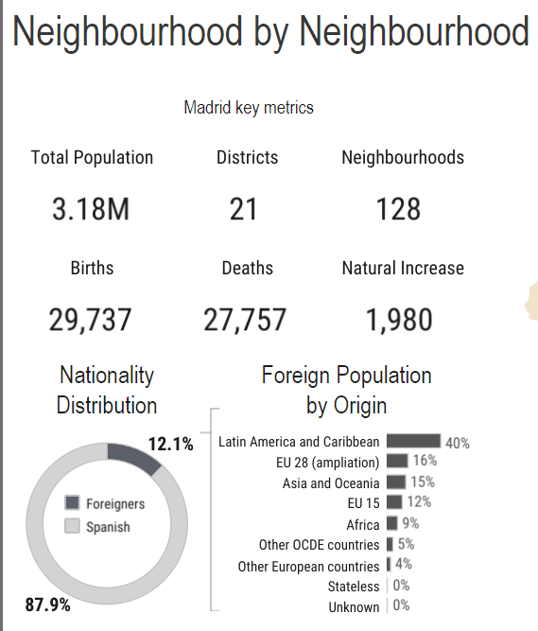
INITIAL FINDINGS : LOOKING AT THE KEY METRICS OF MADRID

Slide 3
ANALYSIS OF MADRID’s KEY FUNDAMENTAL METRICS
**Madrid has a Total Population of 3.18 Million residents
** It has a total of 21 Districts, 128 Neighbourhoods
** For every 29, 737 Births, there’s 27,757 Deaths with a Natural Population Increase of 1,980
** Almost 88% of the population are Spaniards or Spanish-born.
**The non-Spaniard population of Madrid comprises mainly of Latin American & Caribbean Origin
** 15% of the population originates from Asia & the Oceania (AUS,NZ,Fiji,Tahiti,Samoa), 12% are EU residents and 9% are Africans
NOTE: I derived this data from the screenshot prior to this slide. I simply utilized a ‘sniping tool’ and focused on the Key Metrics on the left side of the Tableau dashboard. No specific adjustments to the Level of Detail nor granularities were done.

Slide 4
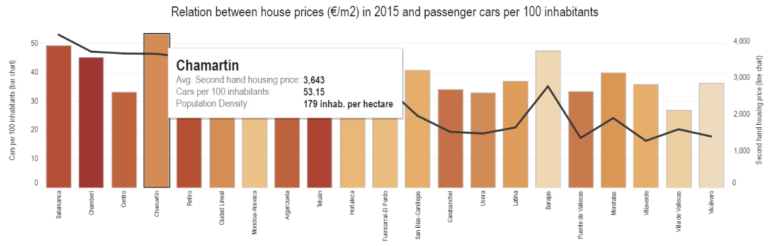
KEY INSIGHT # 1: The Chamartin District has the highest AVG 2nd hand housing price: 3,643 , with 53 cars per 100 residents ** I derived the data from the above visualization. I simply clicked on the lowest part of the dashboard and chose the top which happened to be ‘Chamartin’

Slide 5
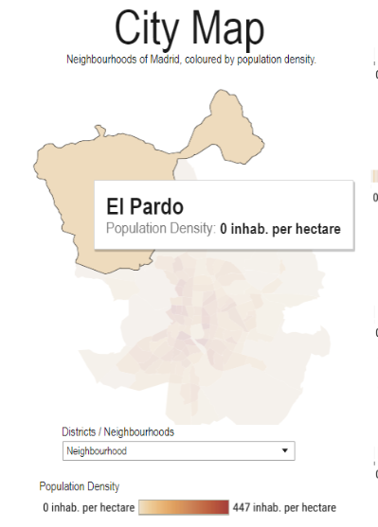
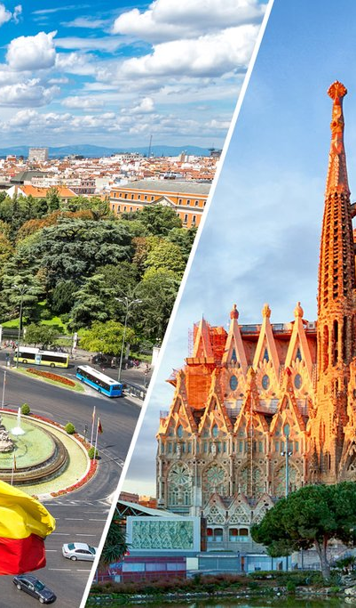
KEY INSIGHT # 2 : THE NEIGHBOURHOOD of EL PARDO has ZERO inhabitants per hectare
** I derived the data by clicking on the map at the middle of the dashboard. I chose the ‘neighbourhood granularity’ and I chose ‘El Pardo’

Slide 6
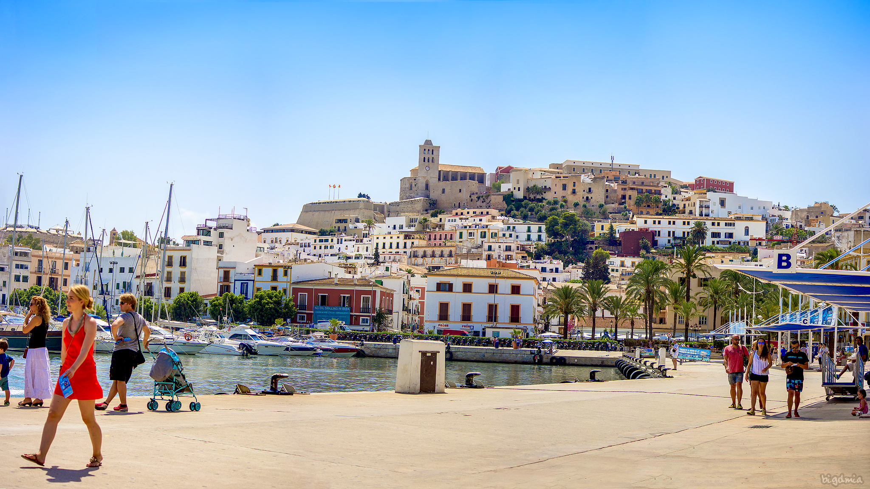
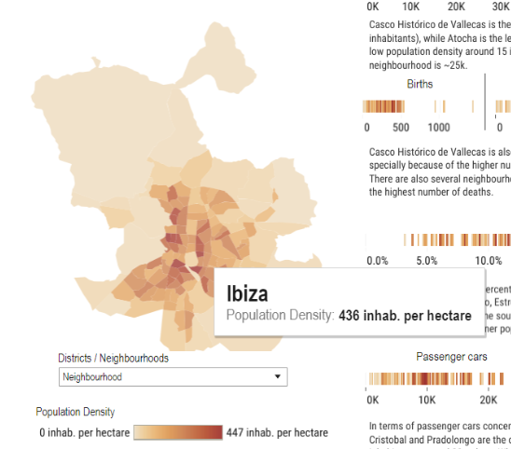
KEY INSIGHT # 3 : ‘Party Town’ Ibiza HAS 436 inhabitants per hectare
** I derived this information by clicking on the map at the middle of the dashboard. I chose Ibiza as my ‘target city’

Slide 7
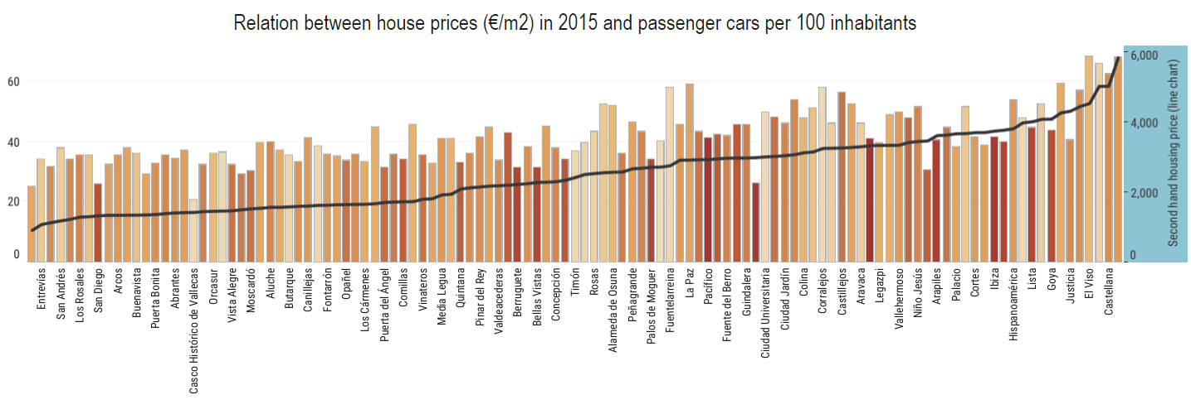
KEY INSIGHT # 4: The neighbourhood of Recoletos has the highest AVG of 2nd hand housing price with 5,843 while San Cristobal has the lowest AVG of 2nd hand housing with 925. ** This data was derived by changing the granularity from ‘district’ to ‘neighbourhood’. Then I used the bar chart at the bottom and I then sorted the values on the right hand side( 2nd hand housing price). I sorted it by ASCENDING (ASC).

Slide 8
KEY INSIGHT # 5: The neighbourhood of Recoletos has the highest cars per 100 inhabitants with 88 while San Cristobal has the lowest number of cars per 100 inhabitants with 25. This has a STRONG INDICATION that the higher the AVG 2nd hand housing price becomes, the higher the # of cars per 100 residents. ** This data was derived by changing the granularity from ‘district’ to ‘neighbourhood’. Then I used the bar chart at the bottom and I then sorted the values on the right hand side( 2nd hand housing price). I sorted it by ASCENDING (ASC).

